Slide 1
Bonneville Academy
Reading Achievement Throughout the School and Title I Overview
2023-2024

Slide 2
What is Title I?
Title I Part A, of the Elementary and Secondary Education Act (ESEA), provides financial assistance to districts and schools with high numbers of students from families who are considered “at-risk” or “disadvantaged”.
Economically disadvantaged, disabled, migrants, or those who have limited English proficiency.
The goal behind Title I is to “ensure all children have a fair, equal, and significant opportunity to obtain a high quality education and reach at least proficiency in state academic standards and assessments”.

Slide 3
Title I Fund Approaches
Title I provides funds to schools and districts to provide additional support and learning opportunities so all students can master the curriculum and meet the states challenging standards.
Two Approaches:
Targeted Approach: Only the percentage of students who are considered “at-risk” or “disadvantaged” are getting supports with funds.
Whole School Approach: Whole school regardless of students who considered “at-risk” or “disadvantaged” are getting supports based on needs.

Slide 4
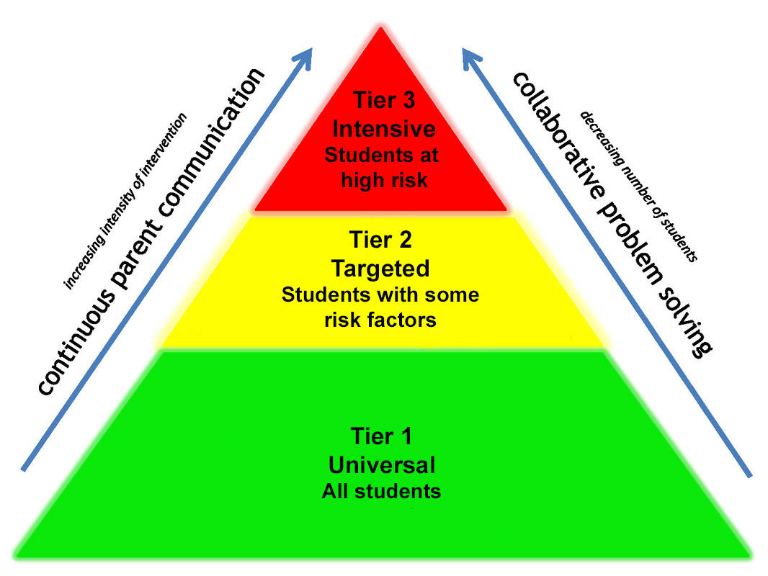
How does Bonneville Academy use
Title I Funds?
About 25% of students qualify as “at-risk” but there is also a large academic need.
Bonneville Academy has established that we will allocate these funds for tiered support for our students.

Slide 5
Why Use Title I for Tier 2 Support?

Slide 6
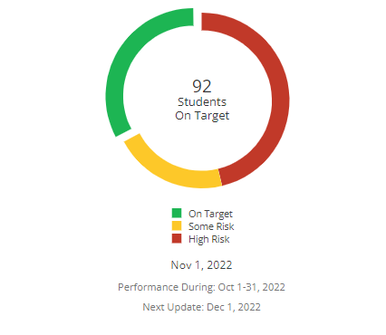
2022 LEXIA Achievement

Slide 7
School Goals and Use of Title I Funds
Bonneville Academy’s Overarching Goal for the 2023-2024 School Year
Bonneville Academy will have at least 60% proficiency on end of year testing and assessment during the 2023/2024 school year.
In order to do this, we have allocated part of our Title I funds for Tier 2 support.

Slide 8
How can you help in this process?
We know parents and family members are huge for student success and we thank you for all that you do!
Some are on school committees which plan and vote for things that our school needs.
Some volunteer in their child’s classroom.
Many work with their child at home to continue their learning and reach out to the teacher.
Plus so many other ways to help!

Slide 9
Parent Rights
Parents have a right to know:
  The curriculum and assessments the school uses
  The qualifications of the teachers and paraprofessionals
  The academic growth of their students
  Information regarding the Title I program and how funds are used
  The policies that are used to govern the Title I program

Slide 10
Parent Involvement
There are many ways parents can be involved in their student’s education
  School committees- research and recommend changes to the school administration or board of directors
  Volunteer in the classroom
  Join the Board of Directors
  Join the Parent Teacher Organization (PTO)
  Support your students at home by helping with work and being prepared to come to school

Slide 11
If you have any questions or concerns:
Franklin Forrey
Academic Director
Franklin.forrey@bonnevilleacademy.org
435-315-2080
Juliette Herrera
Operations Manager
Juliette.herrera@bonnevilleacademy.org
435-315-2080
To learn more about the Title I policies visit the Bonneville Academy website at this link: https://bonnevilleacademy.org/policies/

